Slide 1
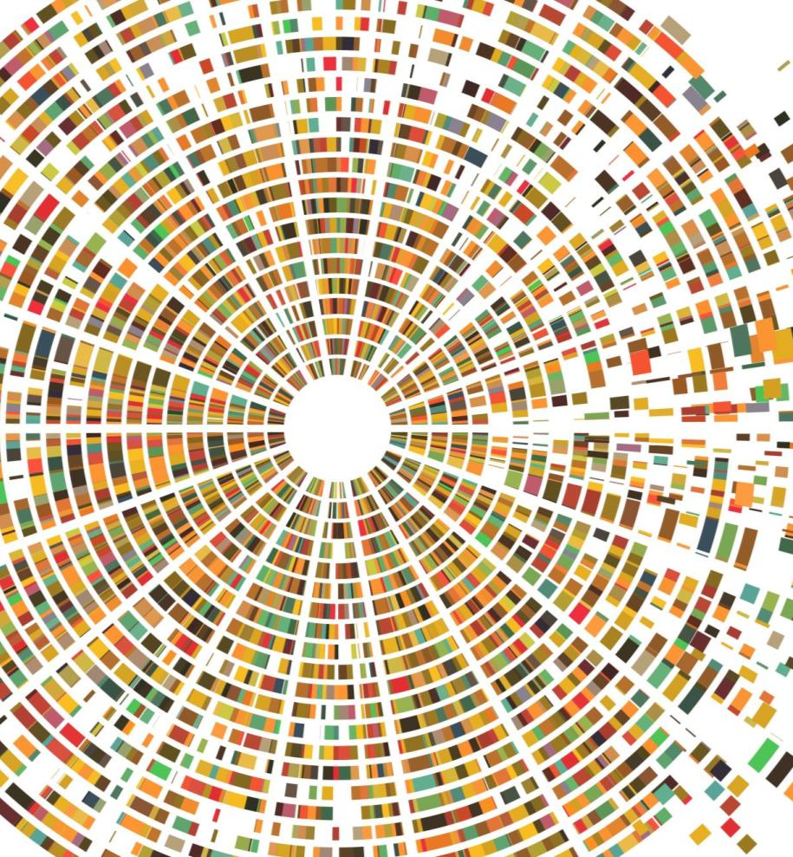
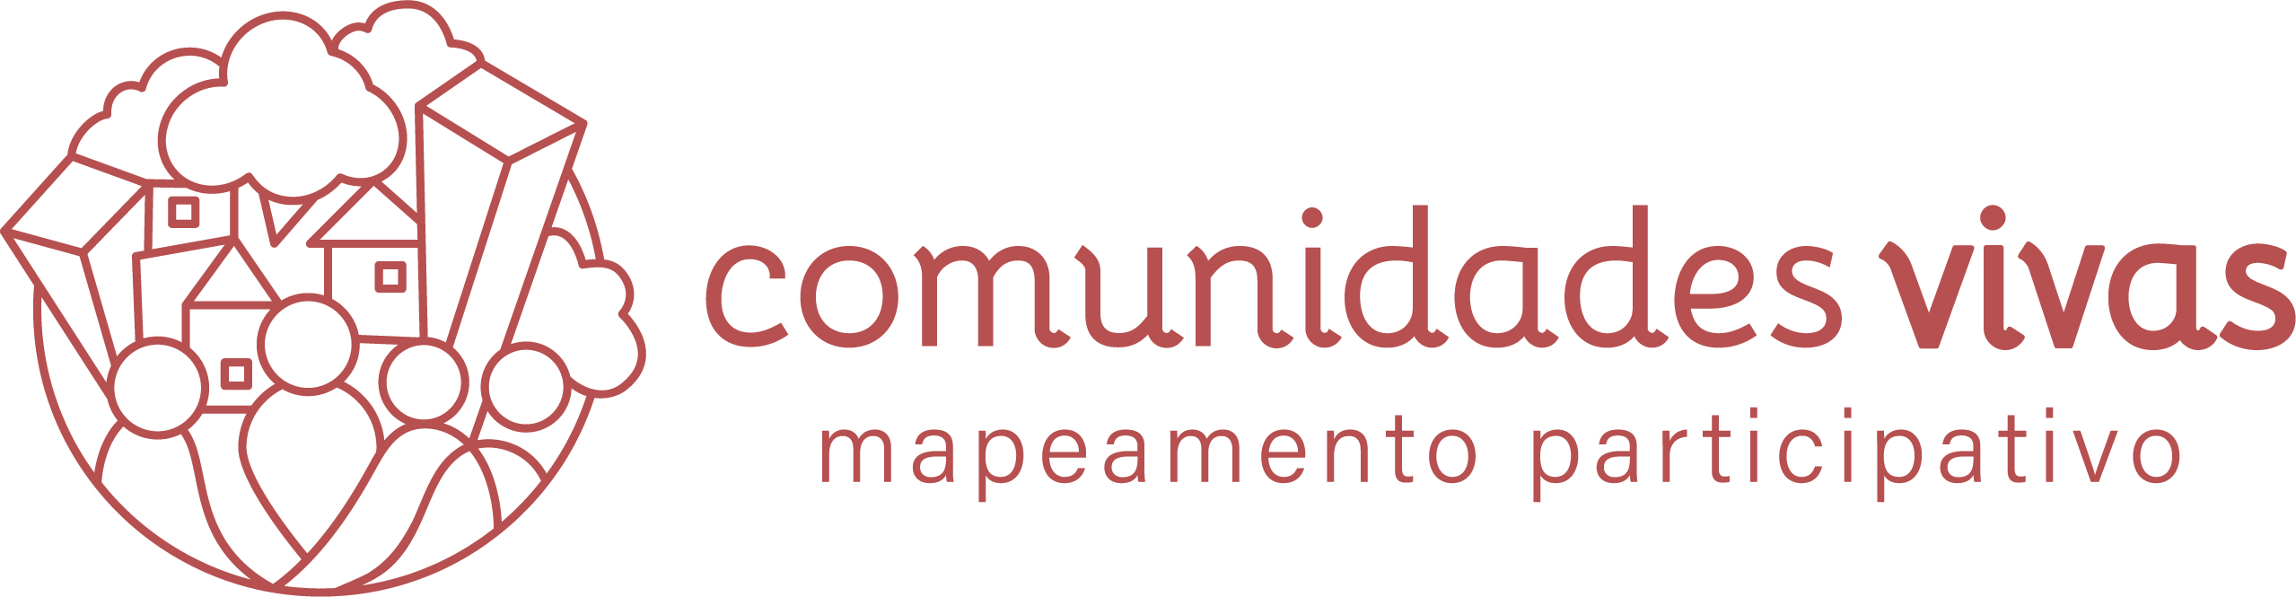
Achieving a new goverance model through participatory mapping
Dr. Carolina Carvalho
Researcher at the Institute of Energy and Environment, University of São Paulo
Founder of Comunidades Vivas (Living Communities)

Slide 2
Objective of this seminar
To understand how participatory mapping and related tools can support the governance transition to better cities and communities.
Please write your Question and Name on the chat.

Slide 3
Why this is important
The current urbanization model has been creating significant negative social and environmental impacts with direct implications for the health and wellbeing of the citizens. Cities are becoming less resilient and vulnerable to climate change, pandemics, etc.
One way to transform this scenario would be to change the way the urban system is managed, in other words, to improve the governance model. Specific tools are needed for that.

Slide 4
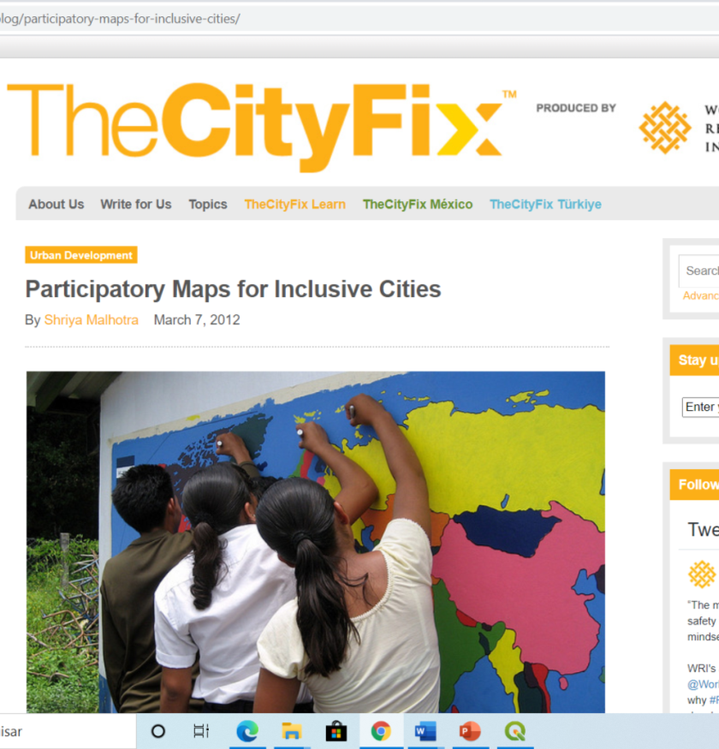
What is participatory mapping (PM)?
“It is a general term used to define a set of approaches and techniques that combines the tools of modern cartography with participatory methods to record and represent the spatial knowledge of local communities.”
Source: https://www.mappingforrights.org/participatory-mapping

Slide 5
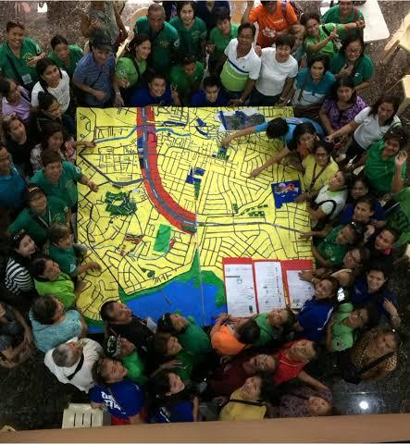
Maps are more than pieces of paper. They are stories, conversations, lives and songs lived out in a place and are inseparable from the political and cultural contexts in which they are used (Warren, 2004).
Maps have the power not only to interpret, but to transform and create the landscape. Maps, indeed, can change the world (GLOBAL ASSESSMENT REPORT ON DISASTER RISK REDUCTION, UNISDR).
Source: https://wpmu.mah.se/nmict182group2/2018/10/23/the-power-of-maps-participatory-gis-for-disaster-prevention/

Slide 6
History of PM
Researchers missed elements that could complement the study of local realities and the understanding of complex demands, especially socio-environmental, and that were not fully provided by traditional maps.
Participatory Mapping emerged in the 1990s, based on this need for additional elements from citizens, providing more integration of data and a new local knowledge, becoming a bridge among citizens and planners (Ferreira, 2012; Kahila-Tani, 2016).

Slide 7
Participatory Mapping and Participatory Geographic Information Systems (PGIS) main tools
PGIS combines a range of geo-spatial information tools and methods such as Sketch maps –3D Maps - Maps in scale - Aerial photos and satellite images – GIS softwares - Online mapping platforms (OpenStreetMap, Maptionnaire).
Participatory mapping is focused on the use of maps and spatial information technologies, but not only GIS platforms.

Slide 8
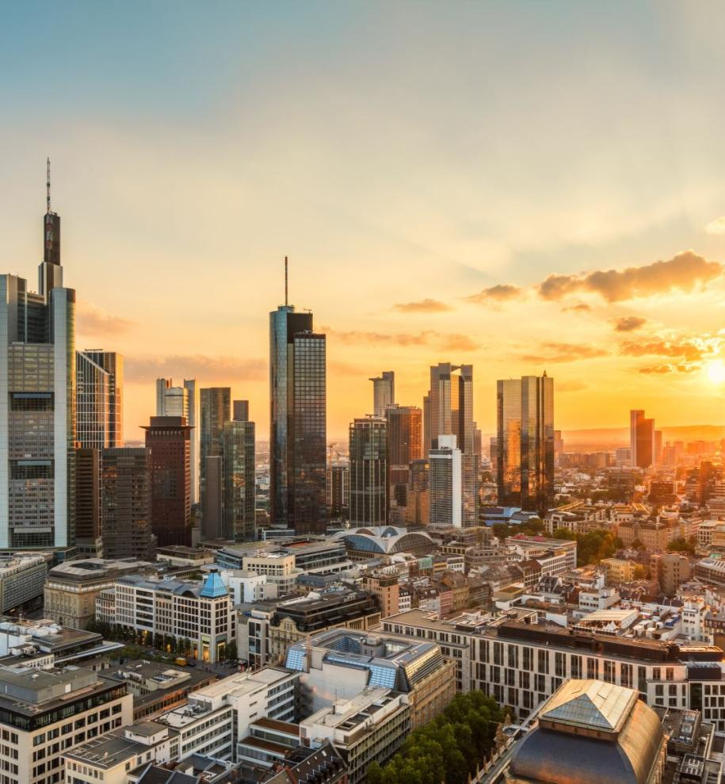
Main applications of Participatory Mapping
Urban Planning
Land use (urban and rural)
Disasters
Health and social behavior
Ecosystem services
Public policy development
Tourism
Agriculture

Slide 9
PM is important for urban research because...
The focus is on local knowledge co-production.
The inclusion of local interests and priorities.
The emphasis on social inclusion.
Capacity building of actors and communities
Flows and trade-offs mapping in urban systems (where resources come from and where they go).
Citizen participation is foundational for the functioning of urban systems and raising of resilience (Arup -https://www.arup.com/perspectives/city-resilience-index)
Promotes multilevel governance

Slide 10
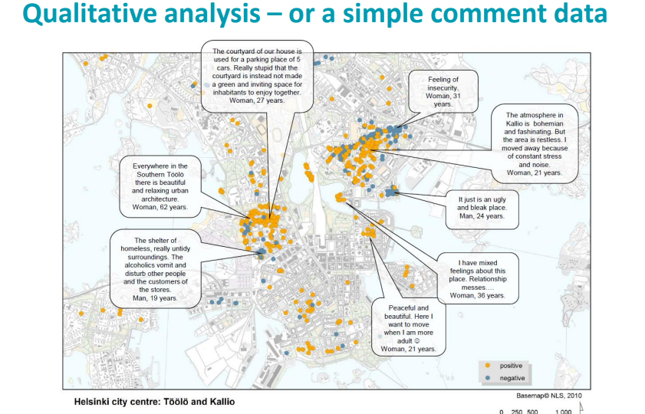
PGIS example from Helsinki (Finland)
Integration with
Urban planning

Slide 11
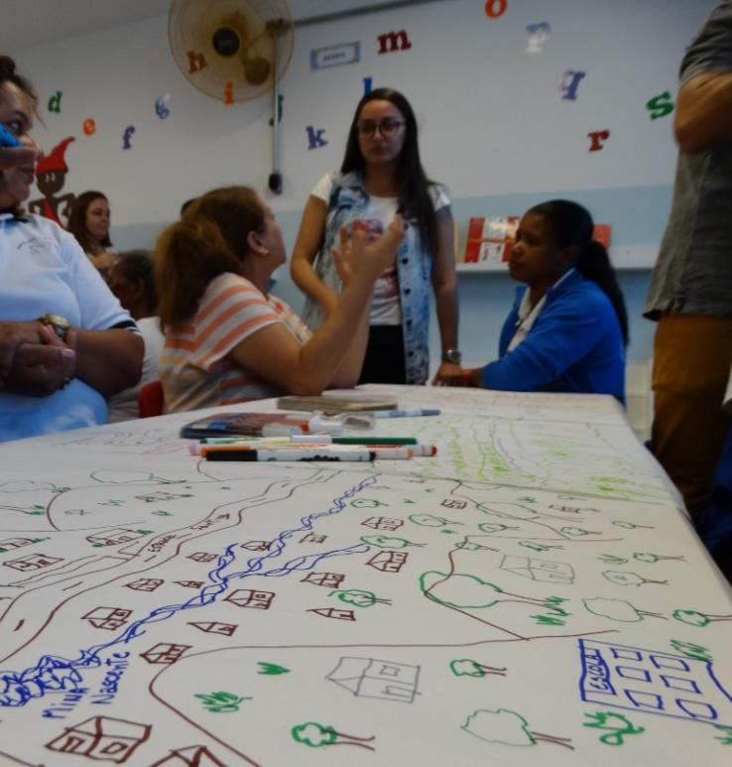
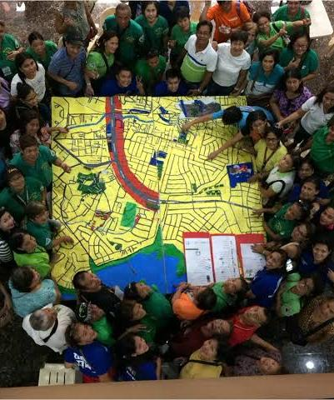
Mapping and integration
Through mapping, a social group identifies situations they would like to change.
This collective practice can provide awareness, being therefore a tool for learning, engagement, action and change.
Projeto Resnexus USP

Slide 12
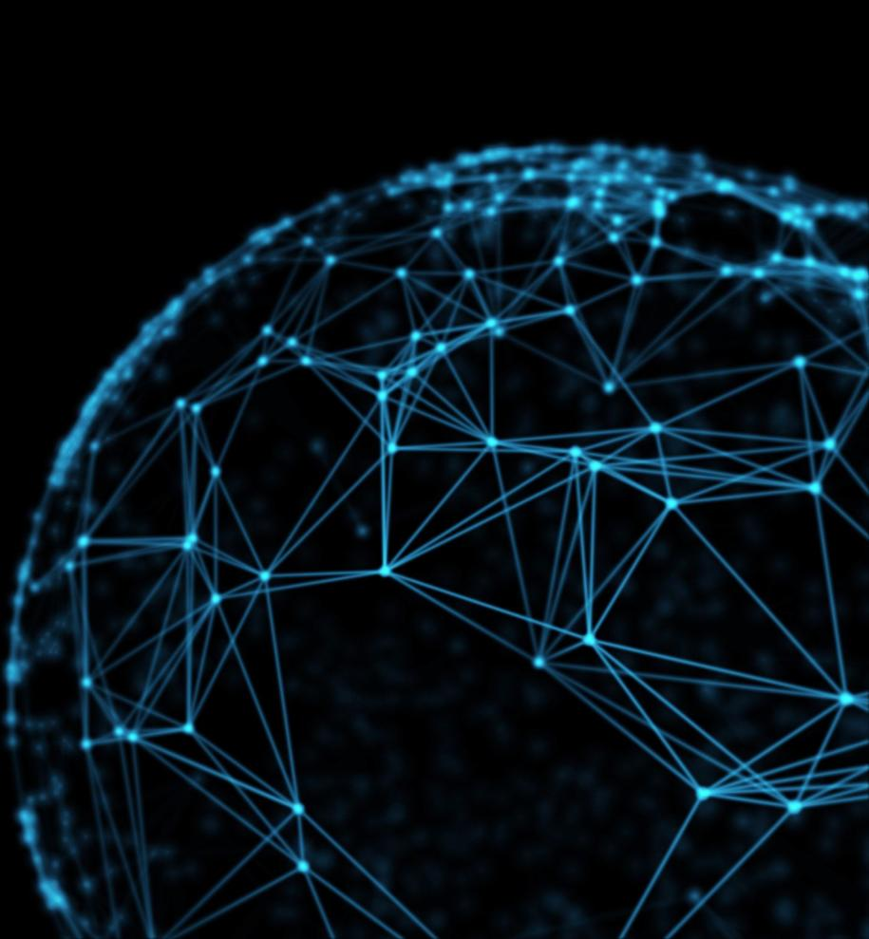
Application of Participatory Mapping in two brazilian informal settlements
Guarulhos, Brazil
São Paulo, Brazil

Slide 13
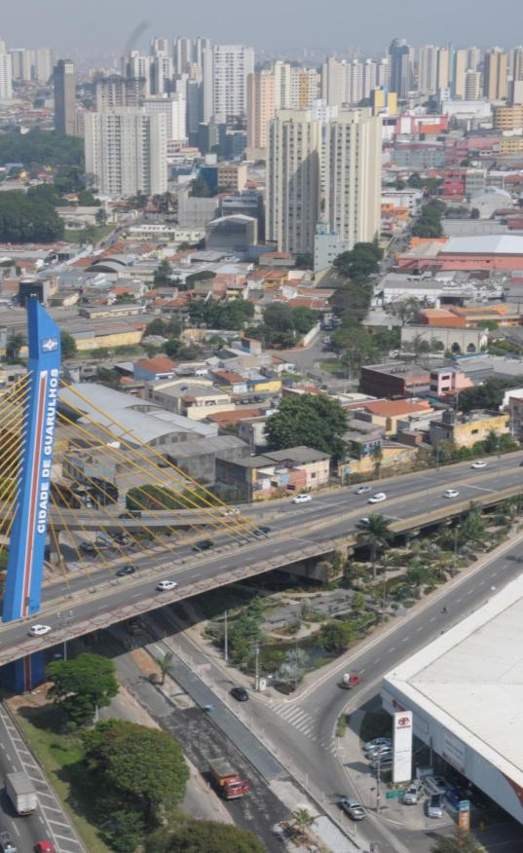
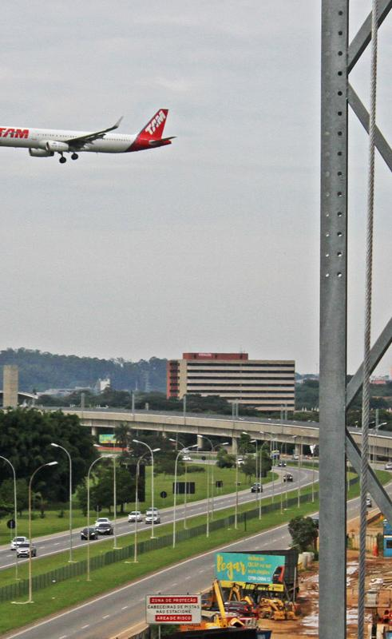
Guarulhos, São Paulo state
https://www.google.com/search?q=guarulhos&sxsrf=ALeKk03JYk4ZW39ScUcgDT1bejsXjCbKXg:1604946444553&source=lnms&tbm=isch&sa=X&ved=2ahUKEwiaw9e1i_bsAhUZF7kGHWQdDoYQ_AUoA3oECAUQBQ&biw=1536&bih=754

Slide 14
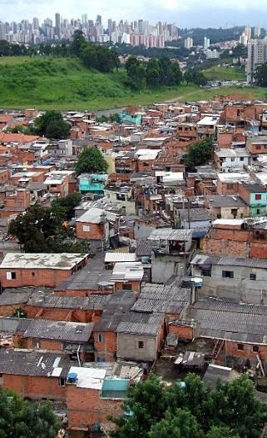
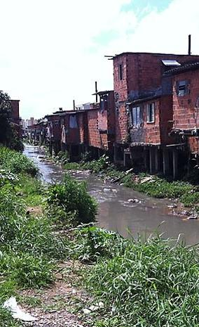
https://www.google.com/search?q=guarulhos&sxsrf=ALeKk03JYk4ZW39ScUcgDT1bejsXjCbKXg:1604946444553&source=lnms&tbm=isch&sa=X&ved=2ahUKEwiaw9e1i_bsAhUZF7kGHWQdDoYQ_AUoA3oECAUQBQ&biw=1536&bih=754

Slide 15
Method
PM extension course in Novo Recreio informal settlement, offered for a youth group.
Participatory mapping in Guarulhos city with Maptionnaire platform : https://app.maptionnaire.com/en/3101/
Validation of results in local workshops.
Dissemination of the findings through articles, blog, social media, lectures, events.

Slide 16
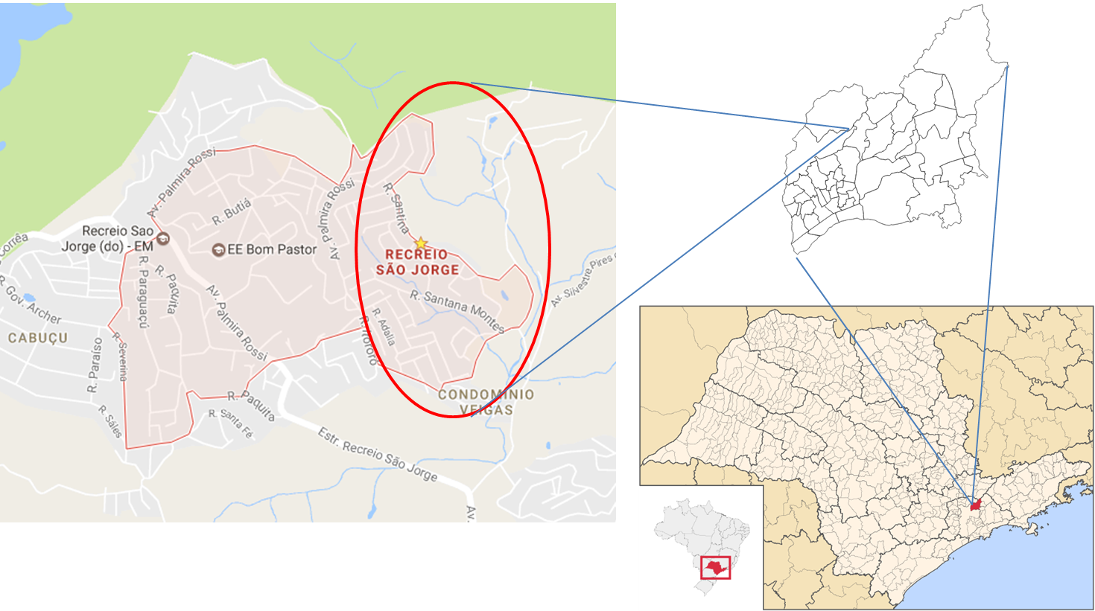
Guarulhos and Novo Recreio location
Source: Adapted from Google Images and processed by Carolina Carvalho

Slide 17
What was done in 2017
Extension course for 22 high school students, between April and June (USP certificate). Partnership with the NGO Clube de Mães.
The main objective was to introduce the fundamentals of mapping and planning practice to create socio-environmental awareness.
Sketch maps; PGIS development (thematic maps); Community Journal; Integrated Panel for strategy development; Online survey for future planning

Slide 18
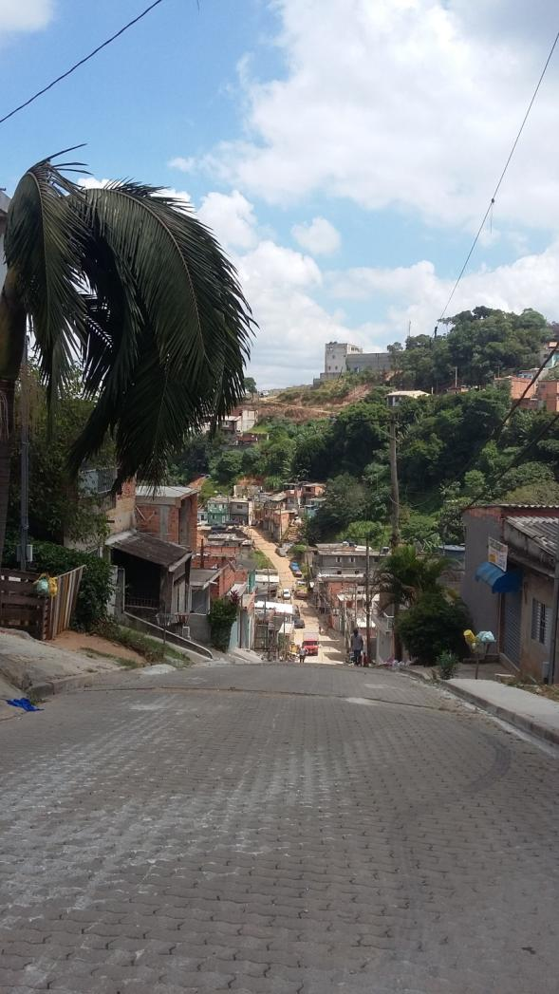
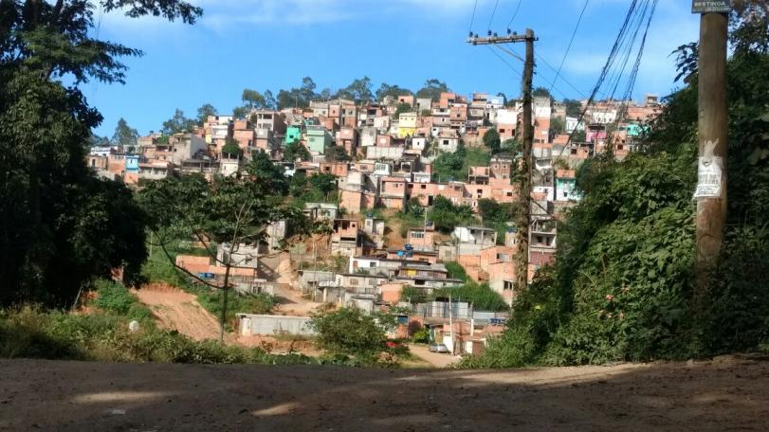
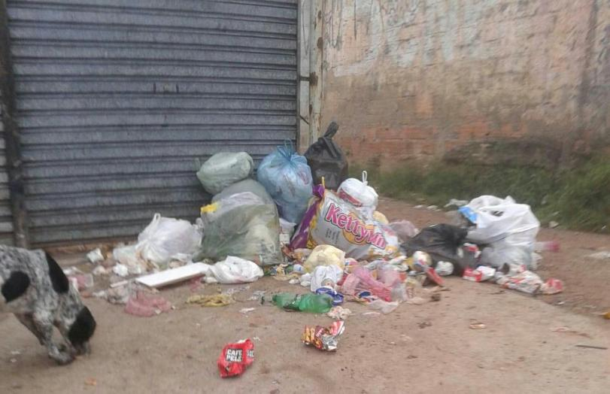
Resnexus Project Pictures

Slide 19
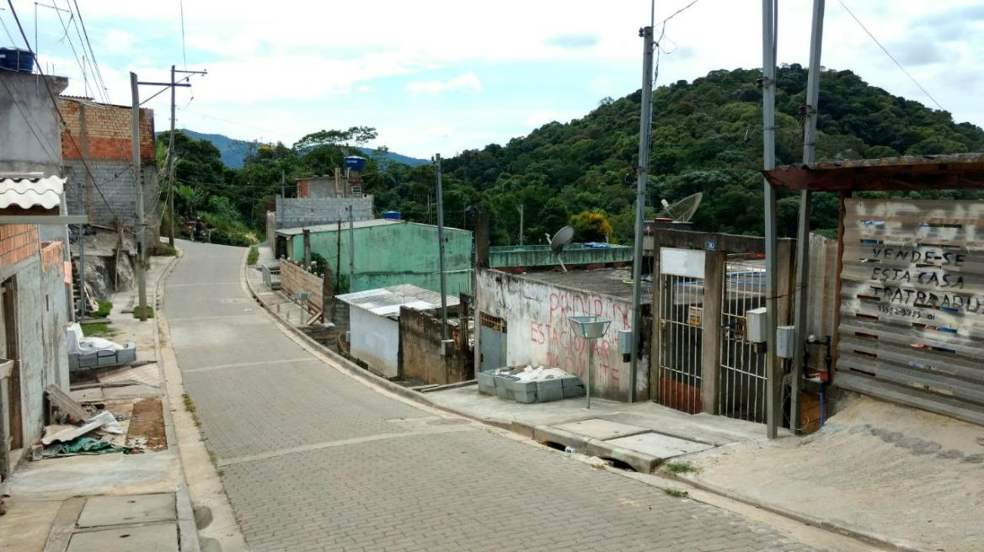
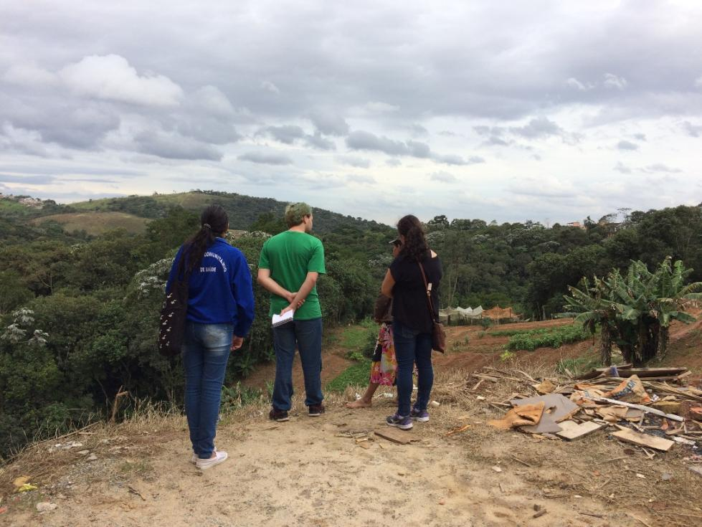
Resnexus Project Pictures

Slide 20
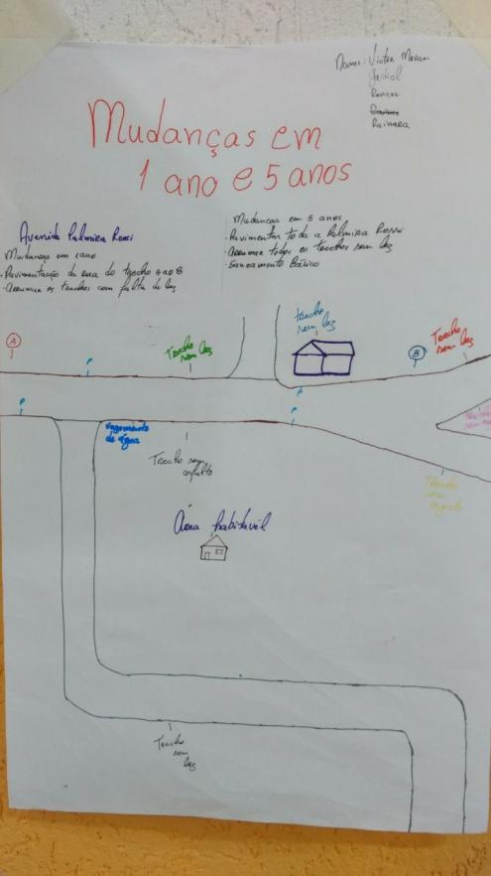
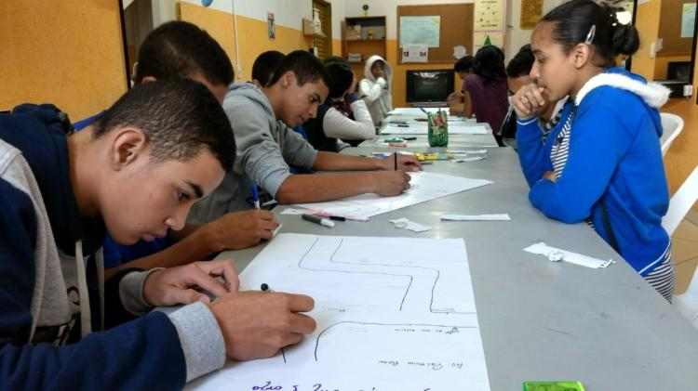
Sketch maps
Planning for one and five years ahead
Source: Carolina Carvalho

Slide 21
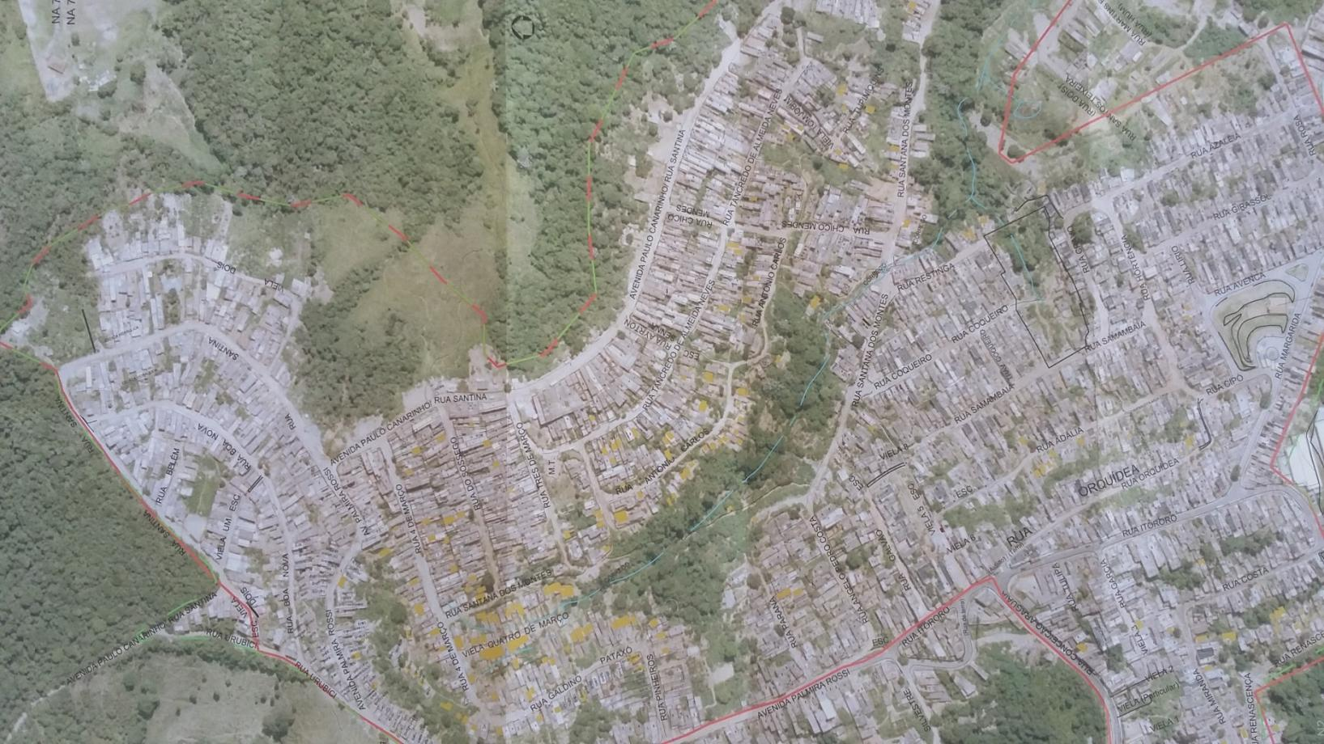
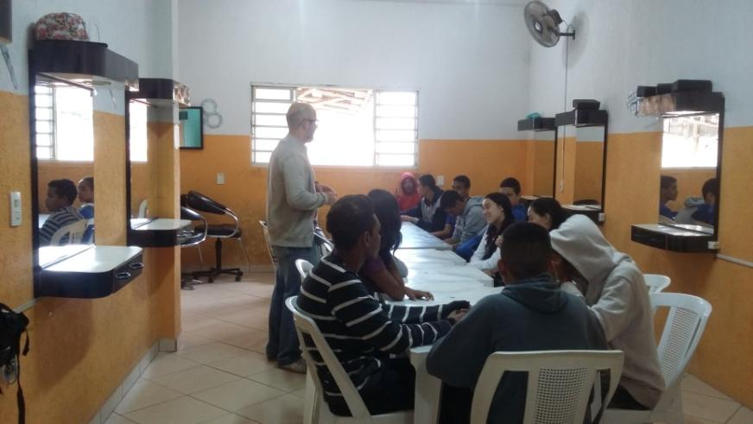
Source: Carolina Carvalho
Base map work

Slide 22
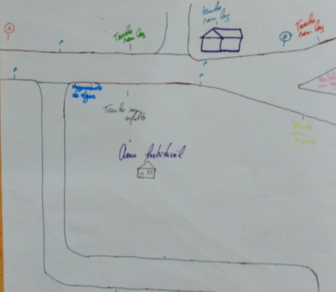
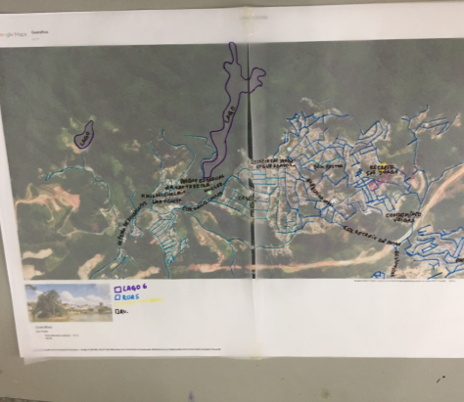
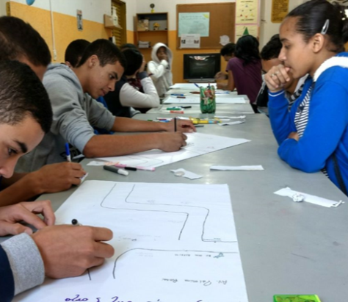
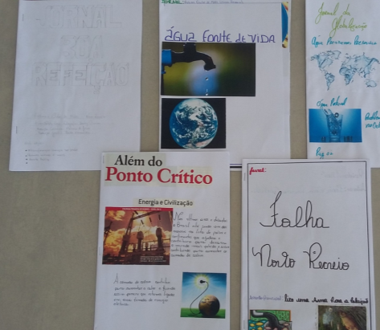
Sketch maps
Maps in scale
Some outcomes and new proposals
Sketch maps
Community Journal and
Integrated Panel
Source: Carolina Carvalho

Slide 23
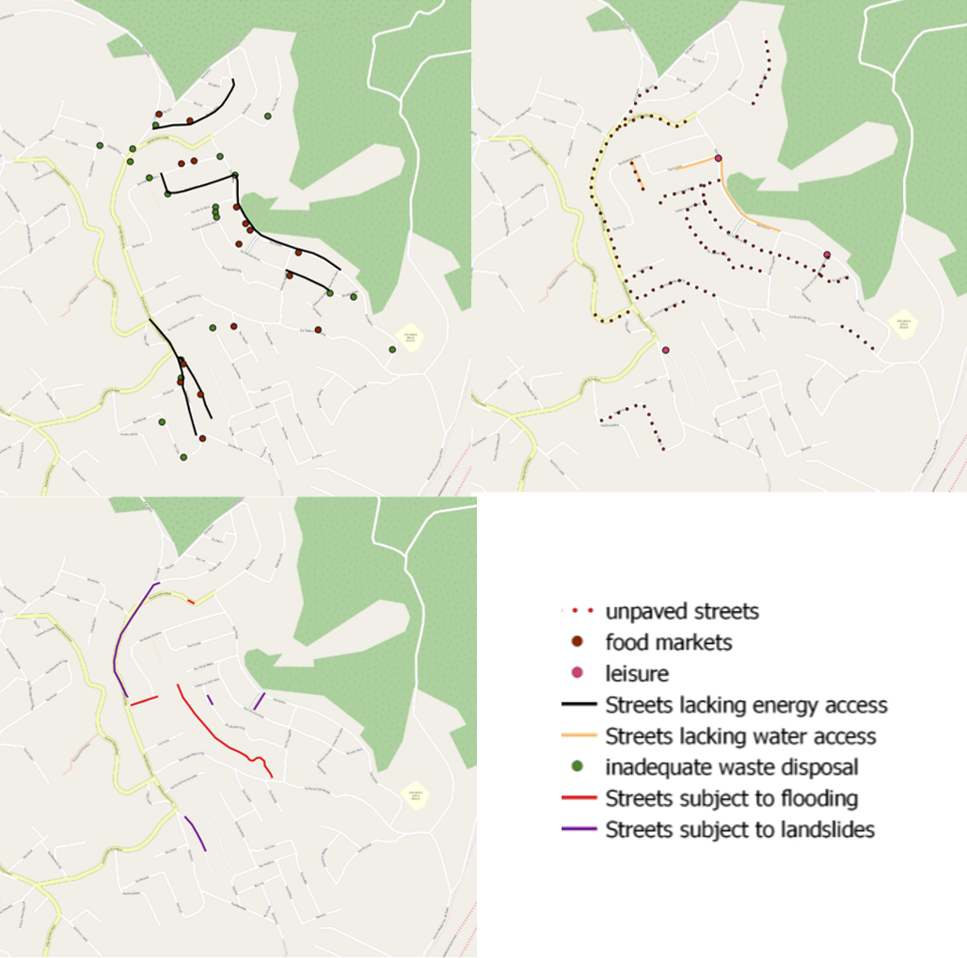
A new product
Source: Carolina Carvalho

Slide 24
New proposals for the community
Better fresh food access (urban gardens)
Water saving and storage, use of rainwater
Renewable energy sources (solar panels, etc)
Suitable place for waste disposal
Environmental education and resource saving
Avoid deforestation
Cleaning up local rivers
Intervention in the mapped points (lack of resources, leakage fixing, etc)

Slide 25

In 2018, survey´s questions for the city www.maptionnaire.com
Map your home and work location (also school, food markets and daily routine)
Map points of lack of water and energy
Map points of waste of water/energy
Suggestions for urban gardens/fresh food markets/public transportation new routes
Answer open question – any other situation that the participant would like to talk or explain, regarding socioenvironmental issues in the city?

Slide 26

Survey´s responses
It received 809 visitors, and 506 citizens effectively answered all the questions, with 2,862 points marked on the map.
It was applied from July to October 2018 and disseminated through Facebook ads and emails.
Analysis: social characteristics of respondents (person-based analysis) and spatial analysis of basic living resources access (place-based analysis)

Slide 27
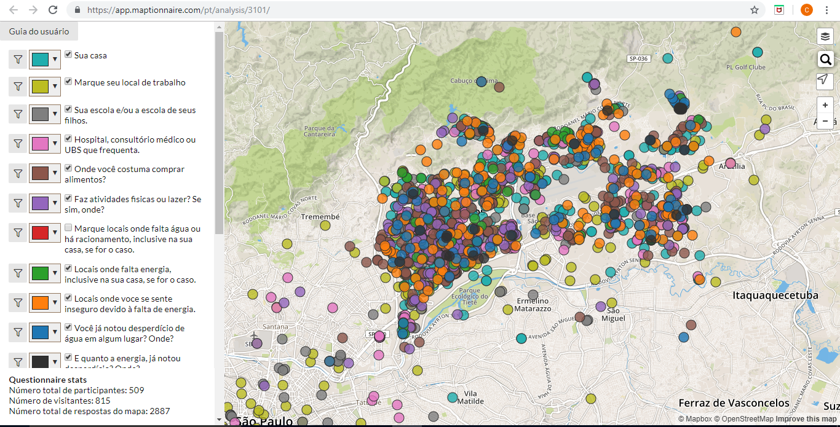
The survey for Guarulhos city in 2018 with maptionnairE www.maptionnaire.com
Source: Carolina Carvalho

Slide 28
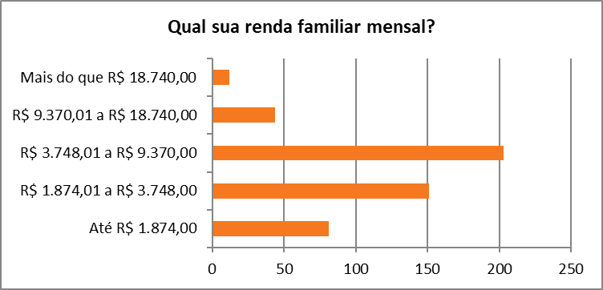
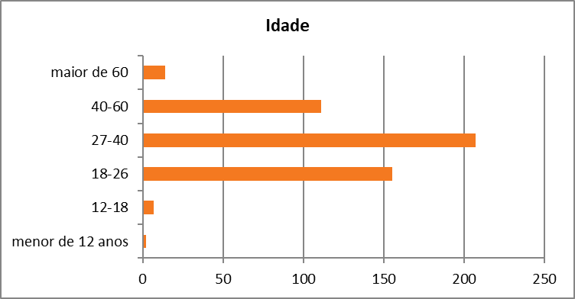
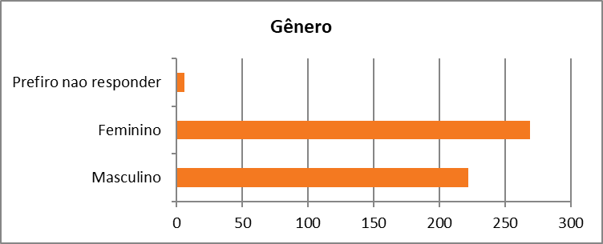
Person-based analysis
Income
Age
Gender
Source: Carolina Carvalho

Slide 29
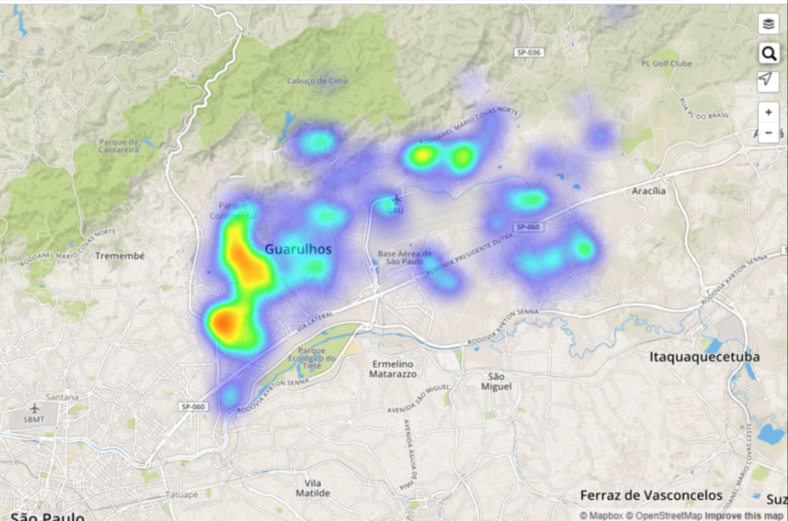
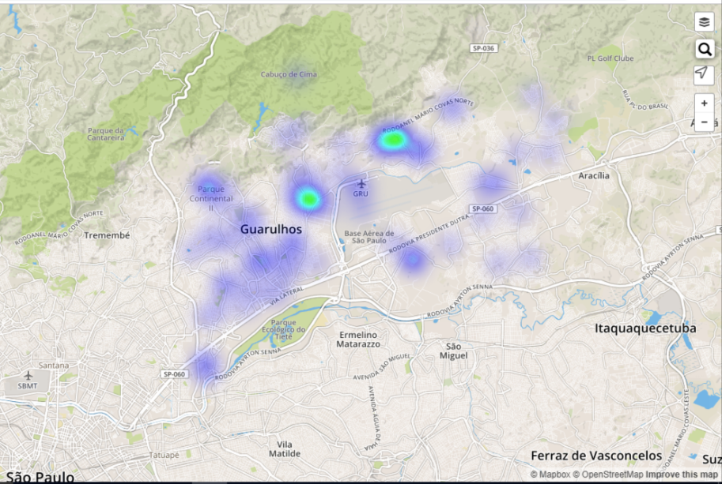
Areas of water/energy insecurity (place- based analysis)
Water
Energy
Source: Carolina Carvalho

Slide 30
CITIZEN´S COMMENTS on the survey
"More quality in public transport, transparency and access to public services, such as waste disposal for example."
"Lack of leisure spaces and environments, lack of planning in urban mobility.“
"I see many bumpy streets, and narrow sidewalks. Traffic is another big problem. Many buildings are being built, but the roads are the same, getting more and more filled with cars. The accesses to Vila Rio for example, are too few and very precarious. In addition, there is much noise at night, and no security. “
And many others… bringing insights for new proposals for the city…

Slide 31
São Paulo (Paraisópolis slum)
Masters Dissertation of Francisco Paiva, FMU- São Paulo, (28/08/2019) "Socio-environmental determinants and health education: an action-research through cultural circles with community health agents from Paraisópolis, São Paulo".
Mapping of positive and negative health determinants in Paraisópolis, with local community health agents (they know the place and the people).

Slide 32
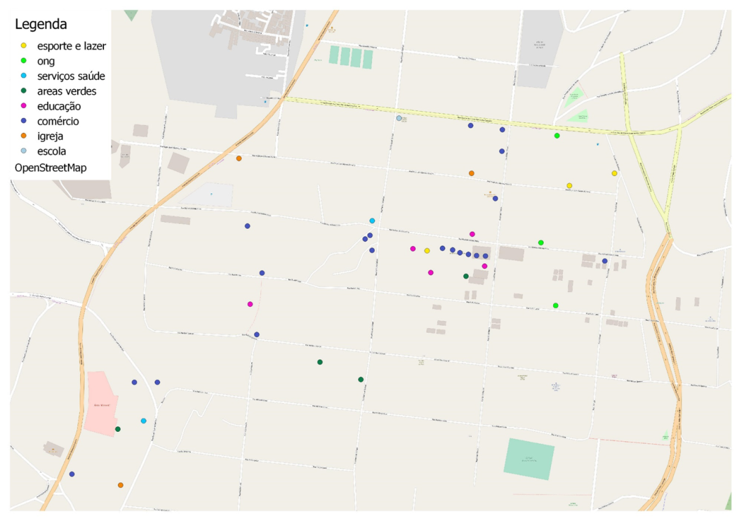
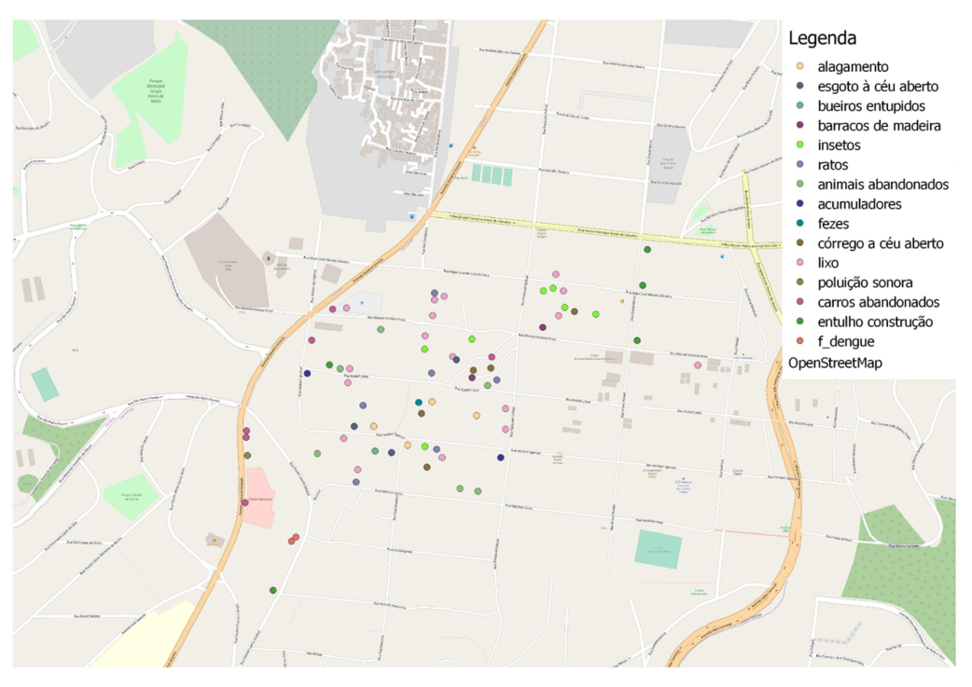
A tool to be used for the health agents
Negative determinants
Positive determinants
(Francisco Paiva, 2019)

Slide 33
Main conclusion
With PM it´s possible to develop new proposals/interventions for cities and communities
Integration with urban planning is necessary
Connection with citizens and planners is an urgent need
Detection of “real” demands from the people
Governance improvement

Slide 34
The most important
The connection between the different participatory approaches in this work makes it easier to define local proposals, and that are not restricted only to the place studied, since access to basic resources depends on municipal policies, and the strategies proposed can then generate impact throughout the municipality.

Slide 35
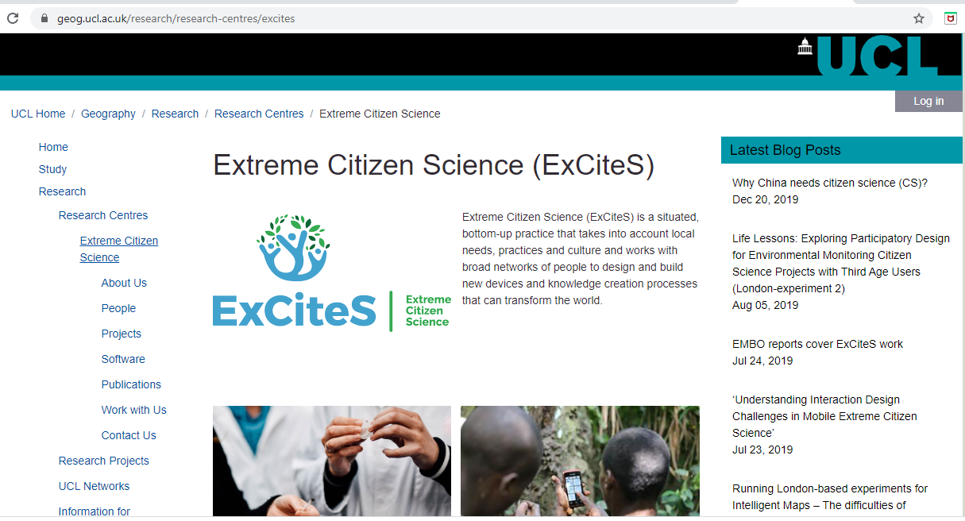
More resources

Slide 36
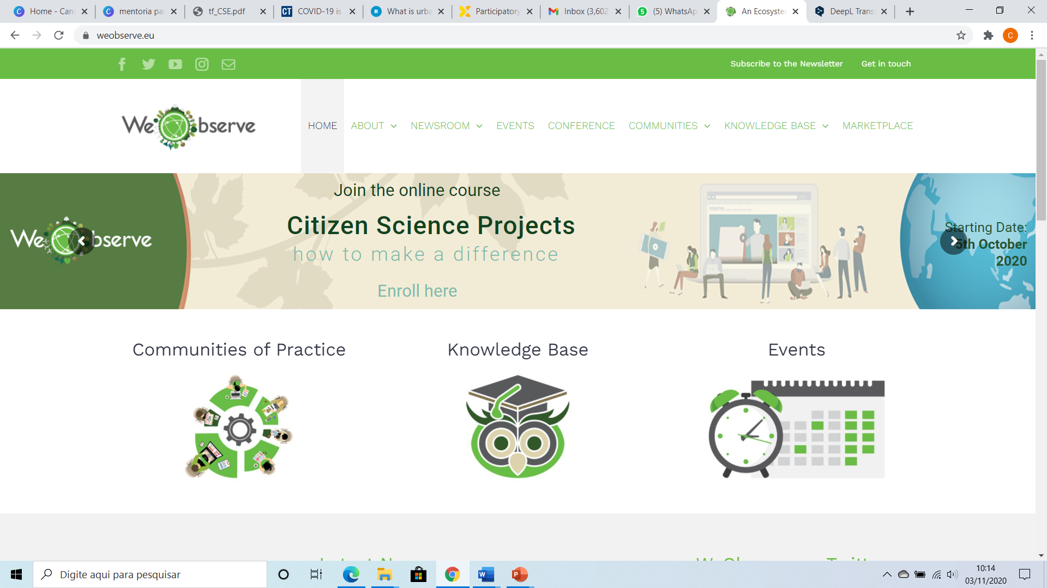

Slide 37
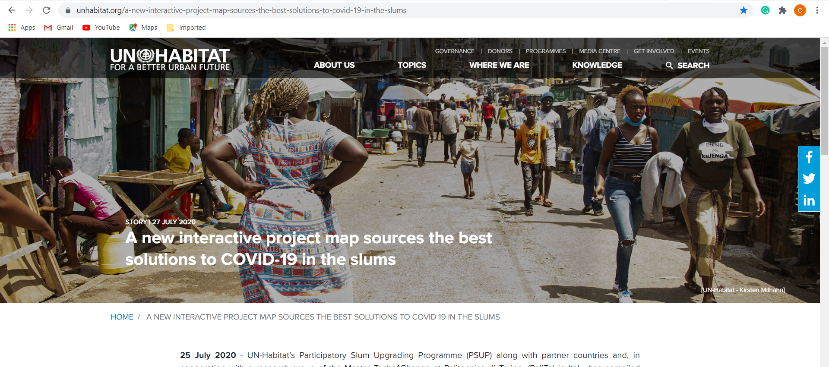

Slide 38
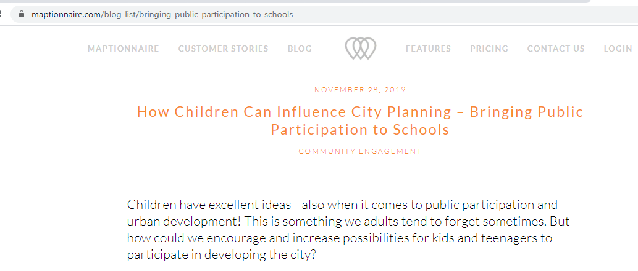
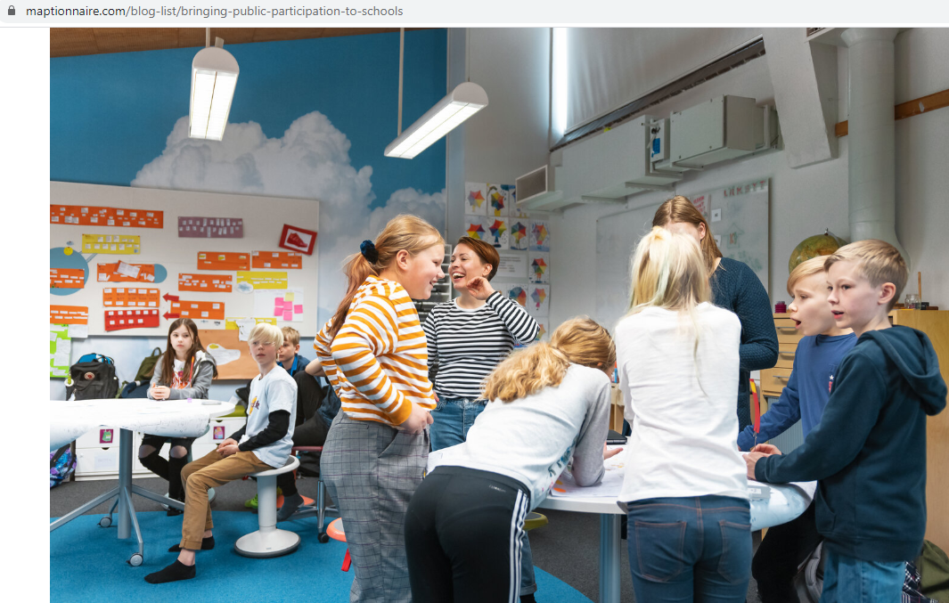
www.maptionnaire.com

Slide 39
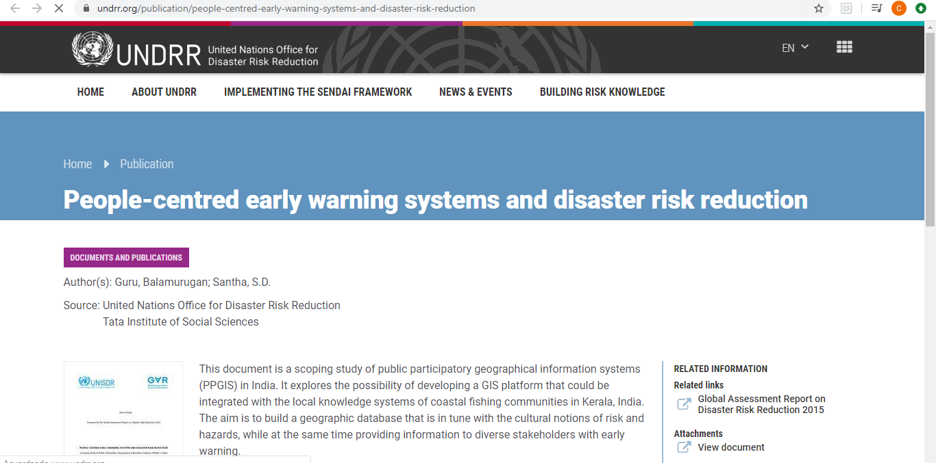
https://www.undrr.org/publication/people-centred-early-warning-systems-and-disaster-risk-reduction

Slide 40

Participatory mapping videos
https://www.mappingforrights.org/How_To_Video_1 (basic concepts)
https://www.mappingforrights.org/How_To_Video_3 (tools)

Slide 41
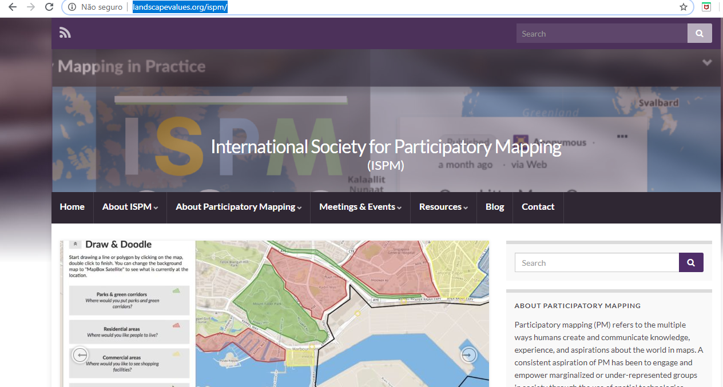
http://landscapevalues.org/ispm/

Slide 42
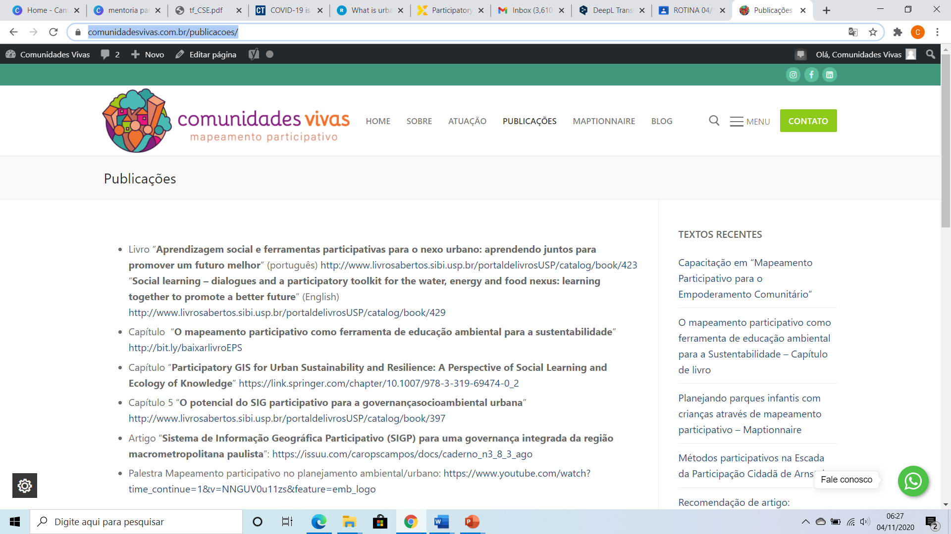
https://www.comunidadesvivas.com.br/

Slide 43
Sign up for support and resources in Participatory Mapping
https://forms.gle/Dthrv8HLuvenRg6d8
Or send me an email: carvalhocm@gmail.com

Slide 44
Thank you!
Q&A

